Slide 1
Attitude Change Project
Gabriel Henderson
Tracy McCutcheon
April 28, 2025

Slide 2
Agenda
Today, I will be going over two different brands of sneakers: ASICS and New Balance.
Through a Qualtrics survey, I gathered data on how the public perceives each brand, and which brand they prefer.
I will go over that survey and all the data gathered, describing each brand and what they strive to accomplish.
The purpose and methodology used will be outlined.
Provide a market analysis to better understand how each brand maintains their market share.
A table of grand means will be included to better understand what our data shows.
Finally, I will outline our attitude change strategy.

Slide 3
Project Overview
• Using Qualtrics I conducted a survey to gather perspective on New Balance and ASICS, where I received 40 responses
• Scenario: passionate runner providing advice to a friend on which pair of running shoes to get
• Purpose: to gather info on consumers’ beliefs behind each brand
• Noticed that ASICS underperformed
• From that, I want to target consumers’ beliefs about ASICS

Slide 4
About the Companies
New Balance
ASICS
New Balance was founded in 1906 in Boston, Massachusetts.
They are known for running shoes, everyday sneakers, and sportswear.
Their brand identity is known for authenticity, inclusivity, and subtle style.
They maintain their reputation through performance, fashion, and orthopedic-grade comfort.
New Balance operates mainly in the U.S. and U.K., supporting local economies and skilled labor.
ASICS was founded in 1949 in Kobe, Japan.
Their core focus is based on athletic footwear and apparel, especially for running.
They are known for integrating sports science into their designs through their ASICS Institute of Sports Science.
They have a strong reputation for durability, foot health, and biomechanical design.
ASICS also puts a heavy focus on sustainability and social impact by using sustainable, eco-friendly materials.

Slide 5
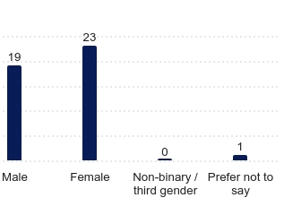
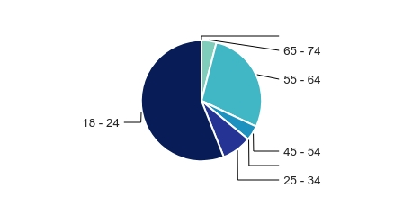
Demographic
(Q4) ‘How old are you?’
(Q5) ‘What is your gender identity?’

Slide 6
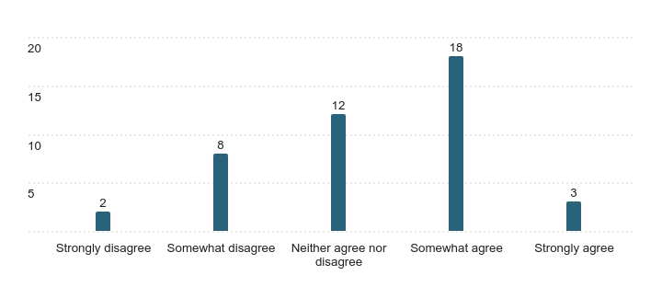
Psychographic
(Q6) ‘I consider myself to be an active and health-conscious individual’

Slide 7
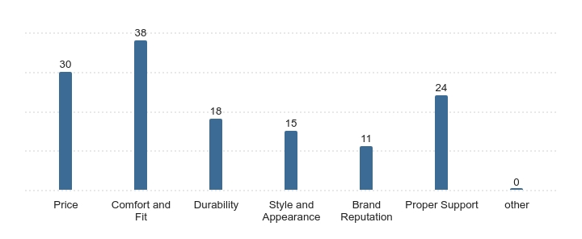
Benefit
(Q7) ‘What factors would influence your decision the most when choosing running shoes?’
Consumers care the most about ‘Comfort and Fit’, with ‘Price’ being a close second.

Slide 8
Market Analysis
Table of Grand Means
Attribute | Importance | New Balance |  | ASICS |  | Gap | + / -
 | Ei | Bi | EiBi | Bi | EiBi
Fall within a reasonable budget | 1.2 | 0.8 | 1.0 | 0.7 | 0.8 | - 0.2 | Weakness
For easier movement | 1.4 | 0.8 | 1.2 | 0.9 | 1.3 | 0.1 | Strength
Provide proper arch and ankle support | 1.6 | 1 | 1.6 | 1.0 | 1.5 | - 0.1 | Weakness
Designed for running | 1.1 | 0.7 | 0.8 | 0.9 | 1.0 | 0.2 | Strength
Visually appealing | 0.5 | 0.9 | 0.4 | 0.8 | 0.4 | 0.0 | Strength
Have a durable outsole | 1.3 | 1.0 | 1.3 | 0.9 | 1.1 | - 0.2 | Weakness
Be a reputable brand | 1.1 | 1.2 | 1.3 | 1.0 | 1.1 | - 0.2 | Weakness
Total (sum) |  |  | 1.1 |  | 1.0
The results yielded in EiBi were similar, but New Balance won by 0.1

Slide 9
Evaluation of Importance
As indicated by the research we conducted, this is what individuals who participated in the survey valued in terms of the importance of things regarding running shoe purchases.

Slide 10
Weighted Brand Belief
- This is the difference between New Balance and ASICS attributes.
- ASICS finished at the top in two categories but ultimately still averaged lower than New Balance.

Slide 11
Total Attribute
While the two were quite similar, New Balance ended up with a higher total. Let's take-a-look at what caused this.

Slide 12


Proposed Scenario
“You’re a passionate runner, and a close friend of yours has decided to start running too. Since they don’t own any running shoes yet, they turn to you for advice on which pair they should buy.”
More people preferred New Balance over ASICS mainly because they perceive it as better priced and more durable

Slide 13
Attitude Change Strategy
- We propose ASICS uses the knowledge function attitude change strategy in a campaign titled "Performance with Purpose." This campaign aims to inform consumers about ASICS' commitment to durability, innovation, and value.
- Given that ASICS scored lower in price competitiveness compared to New Balance and faced concerns about outsole durability, we want to highlight these aspects in the campaign.
- ASICS is known for its advanced technology and premium materials, but we need to show consumers that they are investing in long-term performance and reliability. We will showcase this through a campaign that covers social media, billboards, and digital content, emphasizing ASICS' scientific approach to footwear design and the durability of their products.
- ASICS lost in perceived durability and price justification. We believe people aren’t fully aware of the engineering and research behind ASICS shoes. We need to educate and inform customers about the high-performance materials, rigorous testing, and long-term benefits that ASICS footwear provides.

Slide 14

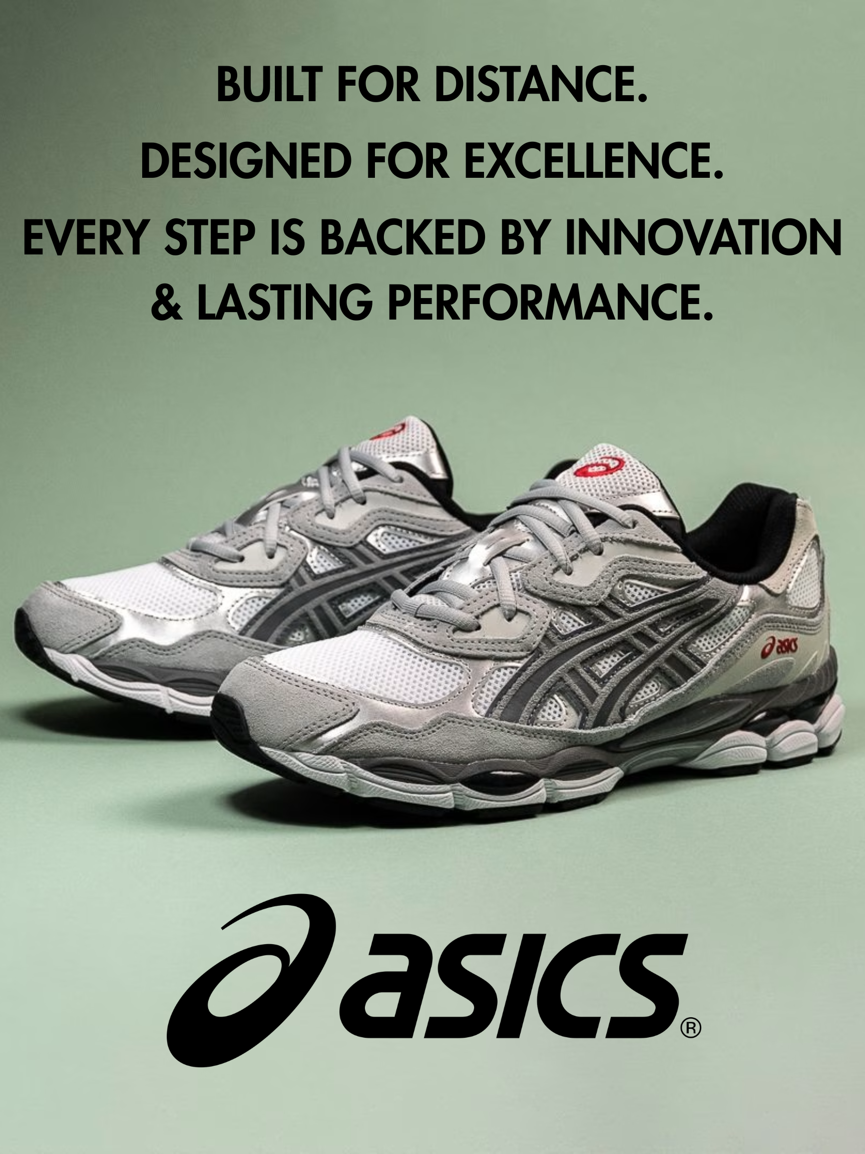

Slide 15
Attitude Change Strategy
This attitude change campaign will shift consumers perception that ASICS provides well-designed durable shoes at a reasonable price.
ASICS integrates patented durability technology to ensure every step is backed by long-lasting performance. This campaign highlights that ASICS isn’t just about style and comfort. They deliver innovation and endurance in every shoe. With advanced outsole materials and precision-engineered cushioning, ASICS proves that high-performance footwear can be both affordable and built to last.

Slide 16
Attitude Change Strategy
Showcasing the power of innovation behind the scenes and giving customers a closer look at how cutting-edge advancements redefine quality and efficiency.
This approach connects with Maslow’s Hierarchy of Needs, emphasizing both esteem and self-actualization. By revealing the meticulous craftsmanship and forward-thinking design, customers gain confidence in the product’s reliability while fulfilling their desire for high-performance solutions without compromise. This reinforces the idea that innovation drives excellence at an affordable price.

Slide 17
Summary
In the survey published, respondents ultimately chose New Balance over ASICS, but by a small margin.
Perception - Consumers felt ASICS did not meet their standards when it came to price and Durableness of the brands products.
Solution - By using the previously referred marketing campaign, ASICS can educate their consumers on the technology and premium materials that are used for their products. All while still being reasonably priced.
If the proposed strategy is utilized correctly and efficiently, this can hopefully change the perceptions of consumers and ultimately grow ASICS market position.

Slide 18
Thank You

