Slide 1

The 4 Motivational Functions of Attitude
Homework Assignment #3
Consumer Behavior
by Gabriel Henderson

Slide 2
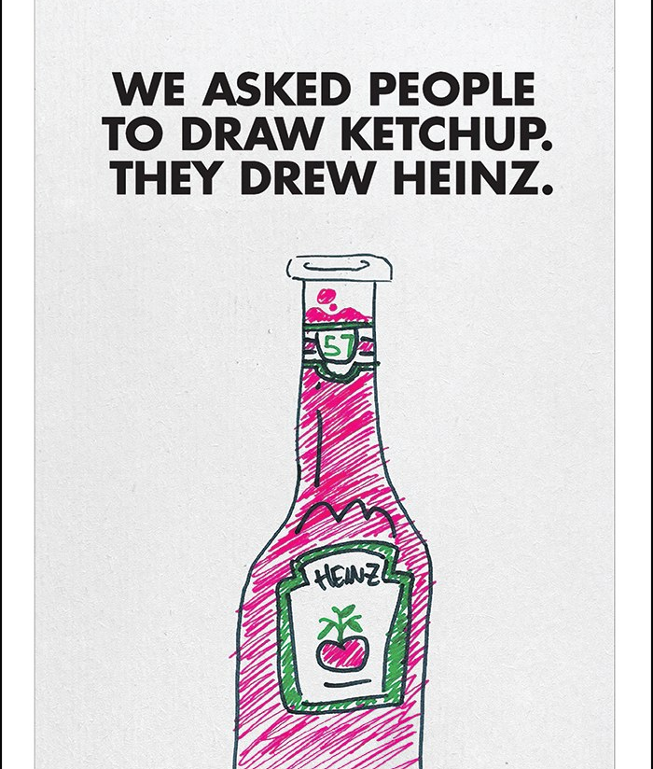
UTILITARIAN FUNCTION -Heinz
This Heinz add is a great example of providing a utilitarian function. It displays that when people think of ketchup, they think of Heinz.
They have positioned their brand to be top-of-mind for consumers. Heinz is a great example of utilitarian advertising because its campaigns often focus on the practical benefits of its products rather than emotional appeal.

Slide 3

EGO-DEFENSIVE FUNCTION -Allstate
This ad fits the ego-defensive function mainly because it taps into customers’ fear of unexpected accidents. Ultimately it reassures consumers that Allstate can protect them from ‘mayhem’.
It highlights how unpredictable accidents can be, making viewers more conscious of potential risks.
Their Mayhem campaign highlights how their insurance protects customers from life’s uncertainties, reducing anxiety.

Slide 4
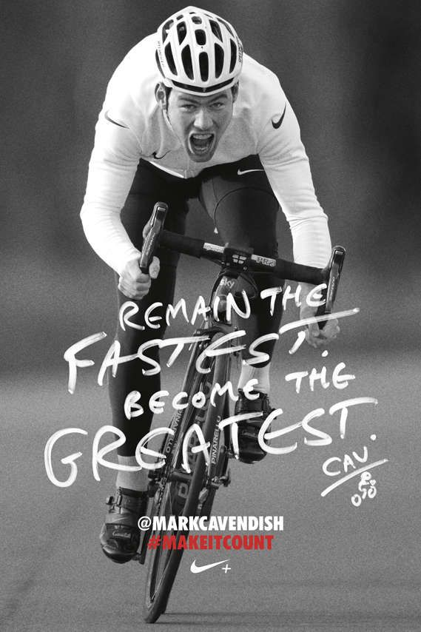
Value-Expressive Function -Nike
This ad fits into the Value-Expression function mainly because it appeals to consumers' personal values, beliefs, and self-concept.
The message in writing of the bottom half states “Remain the fastest. Become the greatest.” This encourages consumers to see themselves as athletes or a person working to reach a physical goal. In doing this, it reinforces the consumers self-image.
All-in-all this ad doesn’t just sell a product; it sells a mindset. It encourages consumers to align themselves with a brand like Nike.

Slide 5
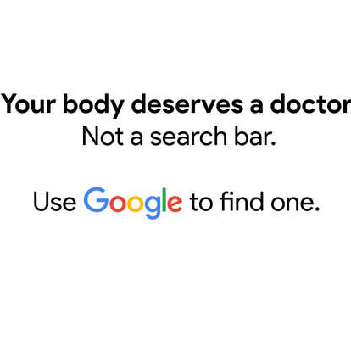
Knowledge Function -Google
This ad is a great example of the knowledge function mainly because it educated viewers and guides them toward making responsible choices based on expert advice.
Many people turn to Google for self-diagnosis, but the ad highlights that medical issues should be addressed by a qualified doctor, not a search bar.
Ultimately this ad fully represents the knowledge function and how effective it can be when used correctly.

